Slide 1
Battery Safety
July 2017
Dr. Matthew Swabey maswabey@purduee.edu

Slide 2
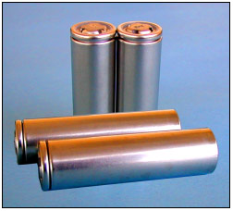
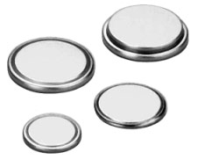
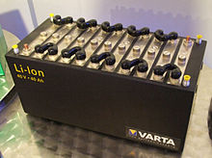
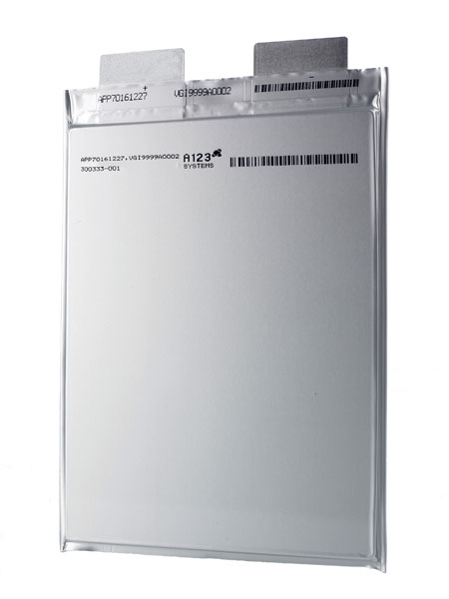
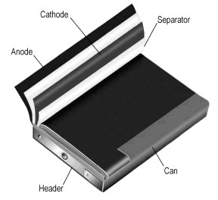
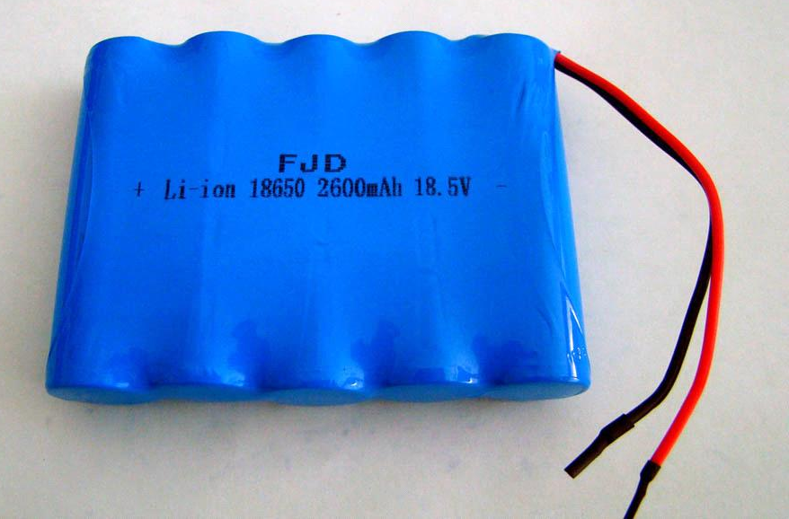
Overview
Size, shape and capacity
Chemistry of battery
  Lead Acid
    Sealed or vented?
    (SLA vs. lead acid)
  NiCad, NiMH
  Lithium-ion Lithium-metal
Precautions and resources
Cylinder Cell
Coin cell
Multi-cell
Prismatic cell
Pouch cell
Multi-cell

Slide 3
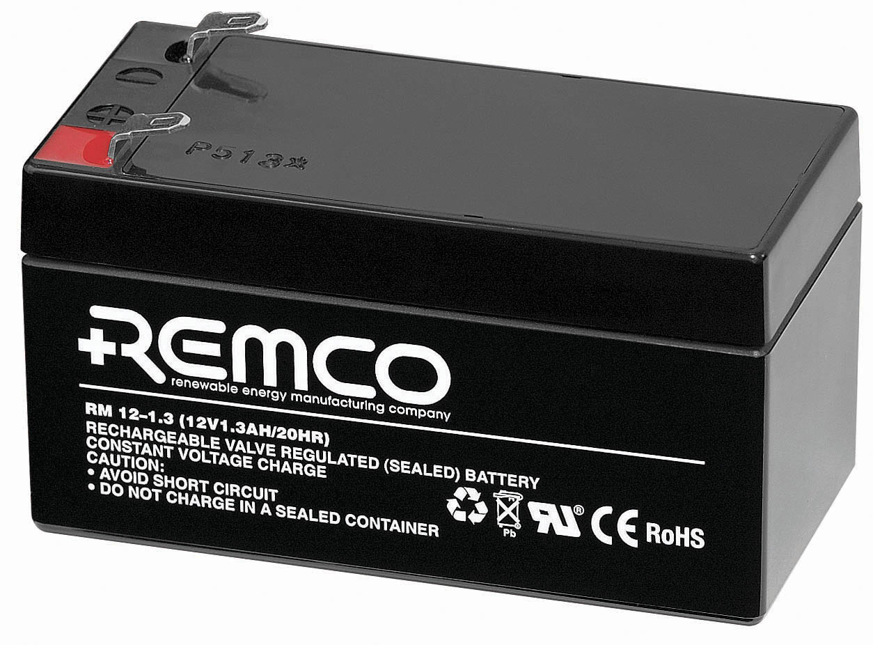
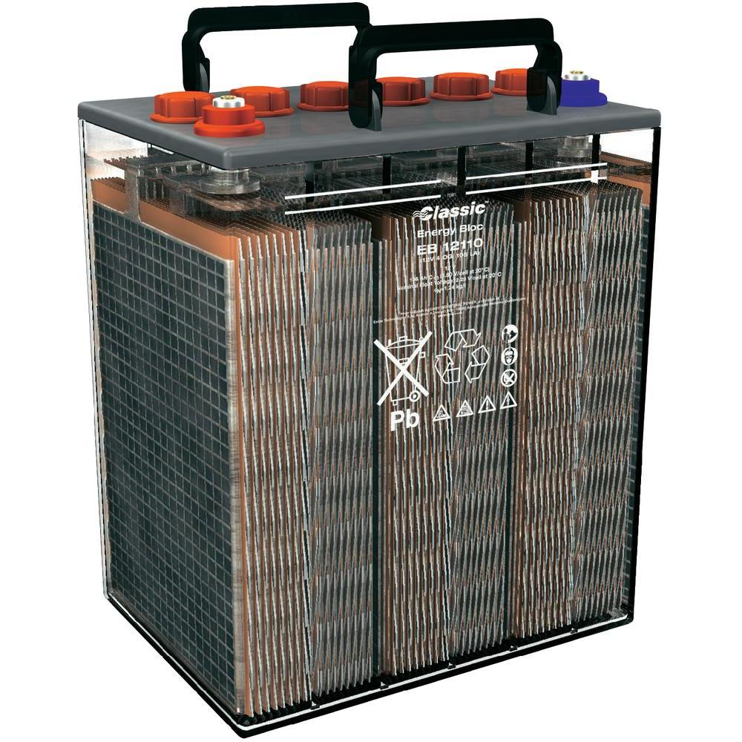
Lead Acid Batteries
Sealed
Sealed
Non-sealed
Non-sealed / Vented

Slide 4
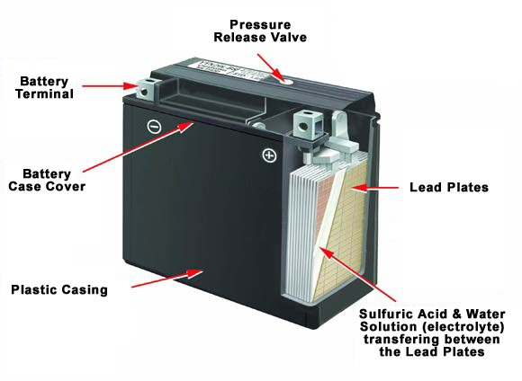
Construction
Typically Lead-Antimony plates
Made up of plates, lead, lead oxide with 35% sulfuric acid and 65% water solution
The solution is called electrolyte, which causes a chemical reaction that produces electrons

Slide 5
Hazards
Hydrogen Gas
Sulfuric Acid
Other Chemicals
Shock
Heating from short circuits, <50V
Weight of the Battery – not discussed further
If >50V, electricity – not discussed further

Slide 6

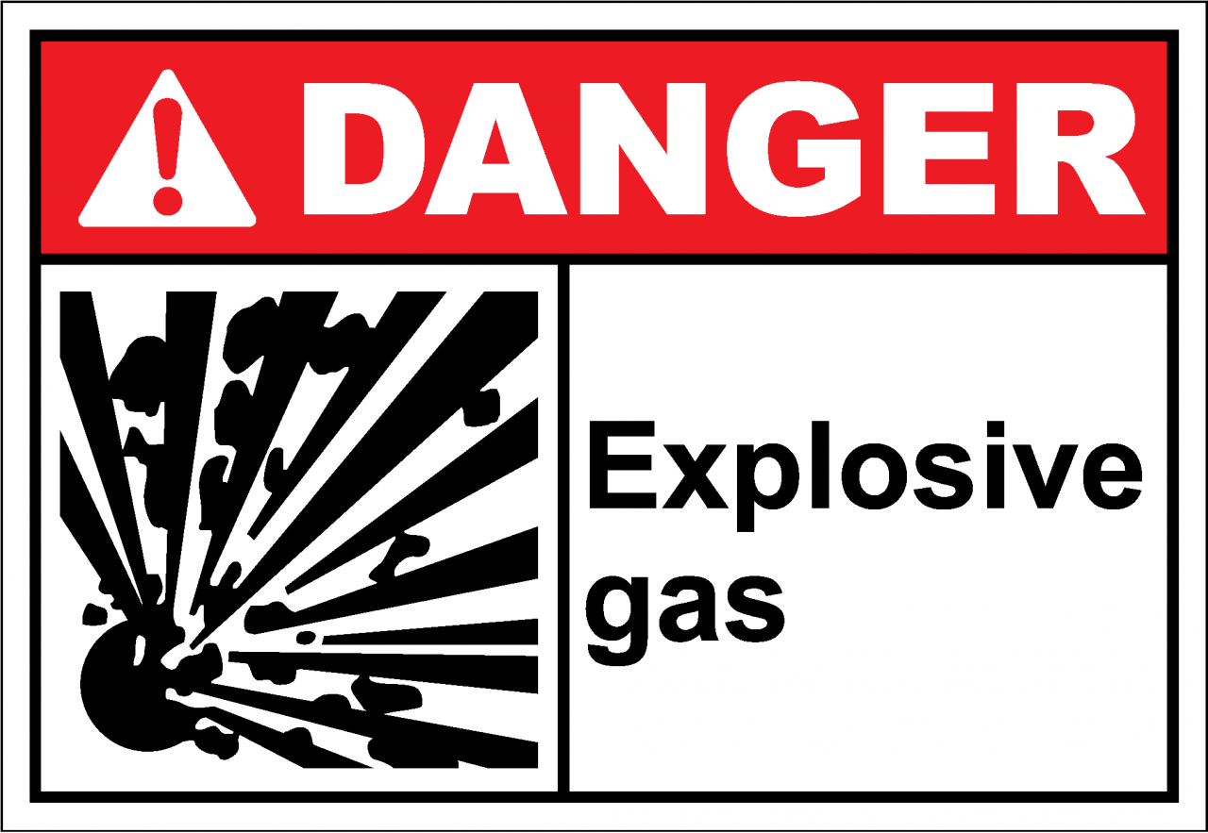
Hydrogen Gas – Non-sealed
A by-product of the battery’s charging process
Lighter than air
Flammable in nature
Explosive mixture at 4 – 74% by volume of air
Can not taste or see the gas vapors. You can smell the acid in the battery if it heats up
Ventilation Essential
Sealed Lead Acid batteries do release hydrogen gas but at about 1/30 rate. If a space supports human habitation it should be safe for charging

Slide 7

Other Chemicals
Depending on construction several other highly toxic by-products of charging can be created
Colorless and odorless:
  Arsenic Hydride, AsH₃, 0.05ppm/8hr
  Antimony Hydride, SbH₃ , 0.10ppm/8hr
Overcharging can lead to Hydrogen Sulphide H₂S
  Smells of rotten eggs
  If you can smell it the danger level has been reached
Ensure adequate ventilation is provided at all times!

Slide 8
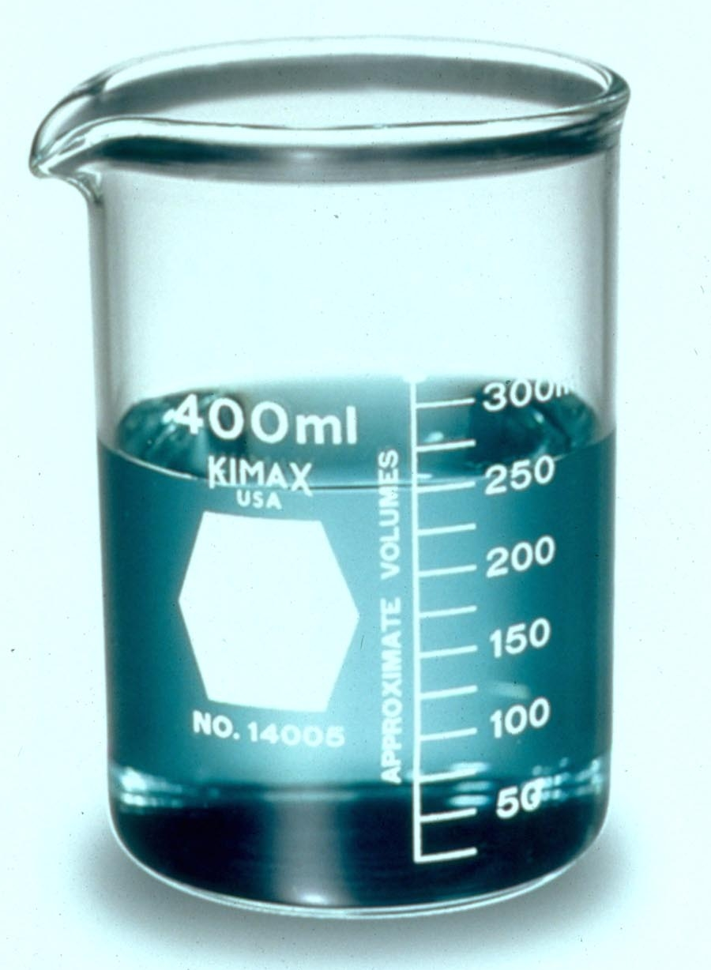
SulphurIC Acid
PH <2 (Typically Sulfuric Acid)
Corrosive material
Burns to skin
Burns to eyes
Never open the battery caps with your face directly over the battery
Always use correct PPE and obtain training to handle acid electrolyte

Slide 9
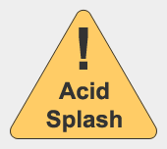
EMERGENCY PROCEEDURE: ACID SPLASH
15 minutes of uninterrupted washing is essential – delay emergency vehicle if necessary
Eyes
Skin
Remove safety glasses and flush eyes with clean water in eyewash for 15 minutes
Seek medical attention immediately
Report the incident to your supervisor.
Remove acid soaked clothing immediately
Flush acid contacted skin with clean water for 15 minutes
Seek medical attention immediately if redness or burns occur
Report the incident to your supervisor.
https://www.osha.gov/SLTC/etools/pit/forklift/electric.html#procedure

Slide 10
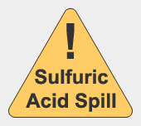
EMERGENCY PROCEEDURE: Sulfuric Acid Spill
Neutralize the spill with soda ash or baking soda. Use 1 pound of baking soda to 1 gallon of water.
The acid reaction is complete when it stops fizzing. Make certain that the acid is neutralized by checking the pH is neutral between 6 and 8.
Absorb neutralized material onto clay or other absorbent material, if necessary. If the spill is very large, contain the spill with earth or clay dikes.
Brush under the battery connectors and remove all grime. Rinse the residue from the battery with clean water with a hose.
Report the incident to your supervisor.
Determine proper disposal by contacting local environmental authorities.
https://www.osha.gov/SLTC/etools/pit/forklift/electric.html#procedure

Slide 11
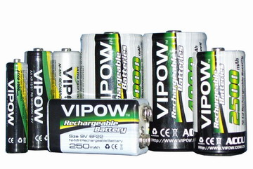
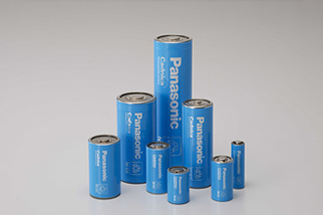
Nickel Cadmium and Nickel Metal Hydride
NiCd and NiMH

Slide 12
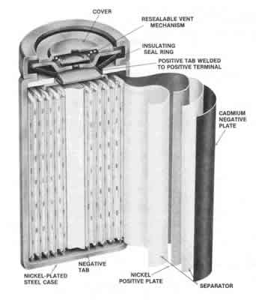
Construction
A “roll” of cadmium or metal hydride, separator and nickel plate
Pressure release membrane
Alkali Electrolyte

Slide 13
Hazards
Cadmium
  More harmful than lead if ingested
  Absorbed through the skin
NiMH is considered non-toxic
Heating from short circuits, <50V, see Lead Acid
Weight of the Battery – not discussed further
If >50V, electricity – not discussed further

Slide 14
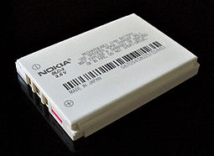
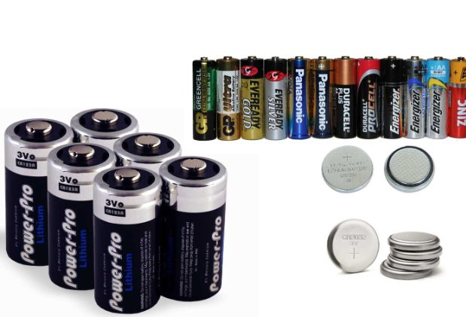
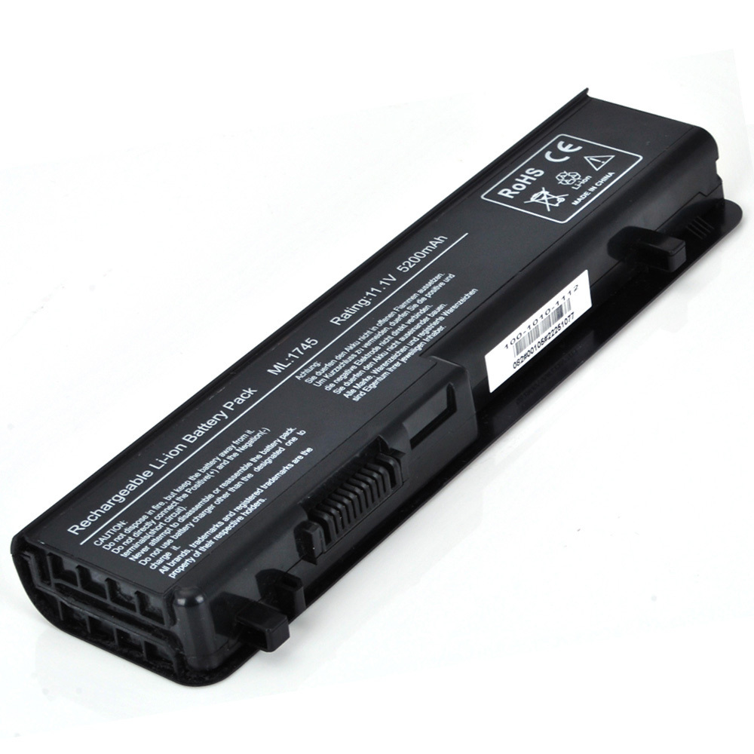
Lithium-ion / Lithium-Metal
Most modern batteries

Slide 15
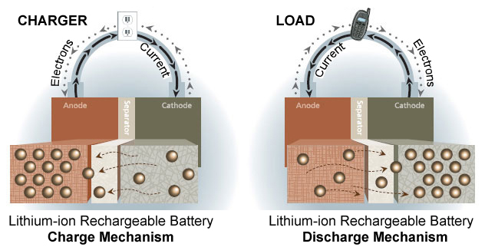
Construction
Electrodes are typically graphite and one of lithium cobalt oxide, polyanion, or spinel [Lithium metal is lithium]
Electrolyte is organic carbonate with lithium ions
Lithium is poisonous and highly reactive with water, creating heat
A heat-activated porous separator membrane should be present to prevent thermal runaway

Slide 16
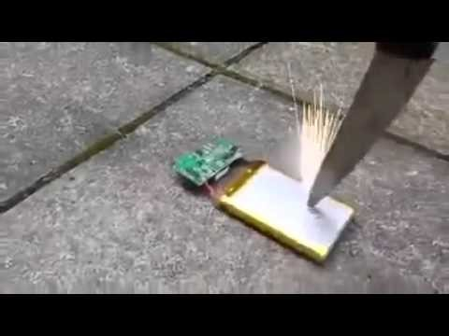
Hazards
Lithium is harmful if ingested
Fire: The electrolyte is extremely flammable
Batteries are very vulnerable to separator damage from crushing, dropping or penetrating
Lithium-ion fire can only be extinguished by:
  Foam, CO2, dry chemical
  Powdered graphite, copper powder, sodium carbonate
  Use water only to prevent fire spread
Heating from short circuits, <50V, see Lead Acid
Weight of the Battery – not discussed further
If >50V, electricity – not discussed further

Slide 17
General Battery Safety

Slide 18

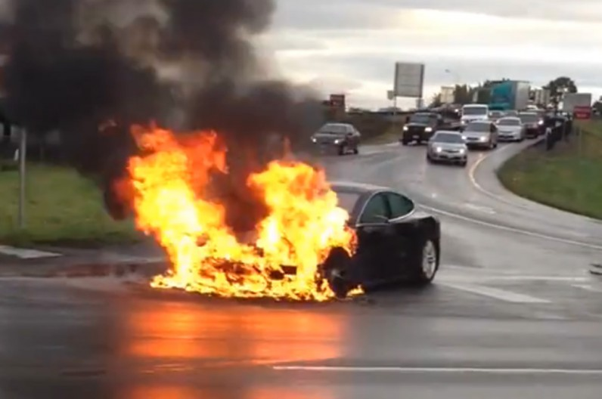
Supply Chain Security
Only purchase batteries and chargers from known good US suppliers with UL marks
  AMAZON – it’s a marketplace not a vendor
  eBay - it’s a marketplace not a vendor
  Grainger
  DigiKey, Mouser, Newark
  SparkFun, Adafruit
Actively police this – do not hesitate to impound unknown batteries/chargers

Slide 19
Physical Protection
Do not handle broken cells
  Li-ion wash hands, don’t touch mouth
  NiCd is toxic to the touch – contact REM
  NiMH is considered safe
  https://www.purdue.edu/ehps/rem/hmm/spills.htm
Dispose according to Purdue policies https://www.purdue.edu/ehps/rem/home/booklets/hwdg.pdf
Batteries should never be:
  Shaken
  Pierced
  Deformed
  Stressed
Hazards are
  Fire
  Leakage of various chemicals
Remember batteries are heavy
Storage in individual bags in a non-conductive box

Slide 20

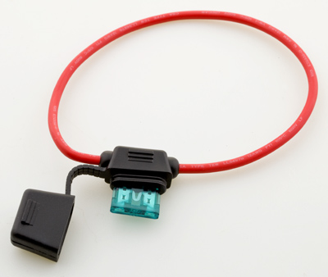
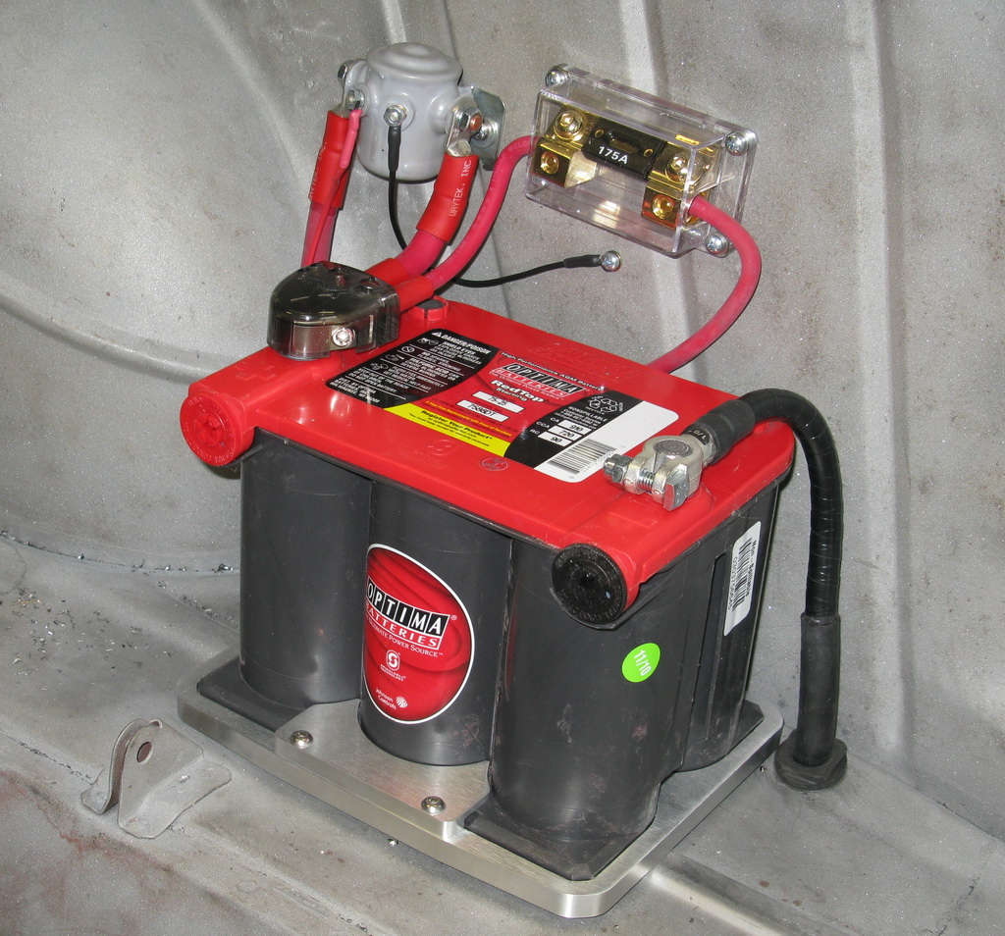
Electrical Protection
Tape all exposed terminals
Inline fuses on battery cables
  Battery sets fused between batteries
Do not allow homemade multicell batteries (without audit)
Never mix sizes, capacities or chemistries in the same battery compartment/multicell battery

Slide 21
Charging Precautions: Lead AciD
Always use a US sourced UL charger
Adequate signs – no smoking, explosive gas hazard
Adequate ventilation provided
Eyewash and running water available
Chemicals for spill management available
Acid resistant floor and shelving required
Do not recharge old or damaged batteries

Slide 22
ingested battery – [more for children]
The battery often gets stuck in the esophagus (the tube that passes food)
Water or saliva creates an electrical current that can trigger a chemical reaction producing hydroxide, a caustic ion that causes serious burns to the surrounding tissue
Doctors often misdiagnose the symptoms, which can be:
  Fever
  Vomiting
  Poor appetite
  Weariness
Batteries that make it through the esophagus often move through the digestive tract with little or no lasting damage

Slide 23
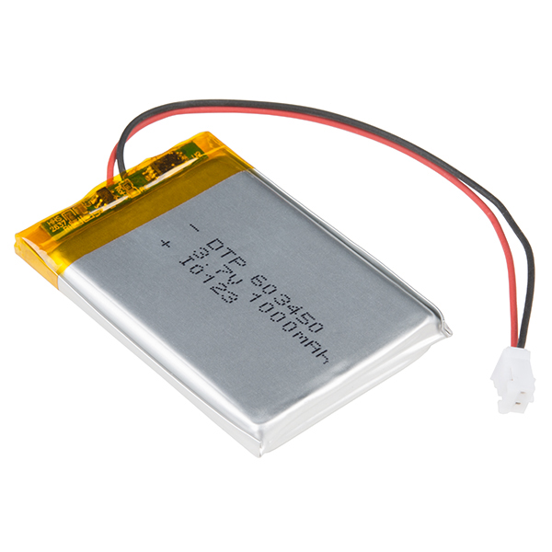
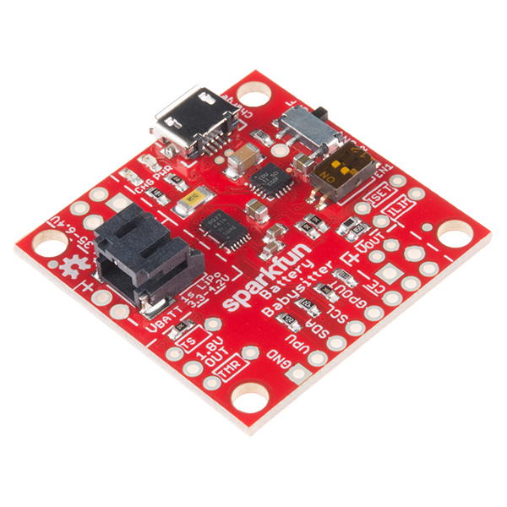
Electronic Projects involving batteries
Use only US sourced cells with a matching charger
Batteries expand when charged – ensure this is accounted for in the space the design allocates
All batteries must be fused - period
No homemade multi-cell batteries without audit
  Charging strategy
  Monitoring strategy on an individual cell basis
  Multicells require fuses between cells
SparkFun LiPo battery and
Battery Manager Circuit

Slide 24
Recommended to create a Battery questionnaire
References to compatibility between charger and battery
  Battery model and vendor – UL approved?
  Battery charger model and vendor – UL approved?
Battery
  Chemistry
  Capacity
Design
  Highest voltage in design
  Deep discharge protection
  Overcharge protection
  Thermal protection
  Fusing strategy

Slide 25
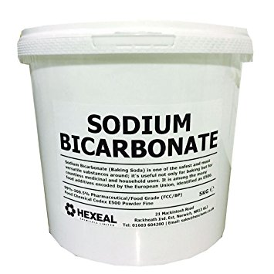
Preparing for an incident
Fire
  CO2 or dry powder extinguisher in proximity and known to students and staff
  Bucket of sand to deposit battery into or sand on top
  Charge on heatproof mat
  Li-ion or Lead Acid: Lidded bucket of sodium carbonate. Extinguishes Li-ion fire and neutralizes acid
Spill or broken cells
  PPE, especially purple nitrile gloves
  Be careful of disposing of multicell batteries that have several cells still charged
Charging
  Charge on a heatproof tile
  Do not allow unattended charging of experimental devices

Slide 26
Resources
General information: http://batteryuniversity.com/
Lead acid Powered Industrial Trucks OSHA eTool: https://www.osha.gov/SLTC/etools/pit/forklift/electric.html
Purdue REM
  Disposal: http://www.purdue.edu/newsroom/purduetoday/releases/2014/Q3/battery-disposal-when-rechargeable-isnt-reusable.html
  Spills: http://www.purdue.edu/newsroom/purduetoday/releases/2014/Q3/battery-disposal-when-rechargeable-isnt-reusable.html

Slide 27
General Precautions
Do not swallow or eat – especially small children
Check manufacturer specifications for appropriate charge level for long term storage

